Slide 1
Museum of Discovery & Science To Fly
Sarah Valme – User Interface
Dario Loriato – Graphics
Kevin Deng – Java Programming
Summer 2015

Slide 2
Objective
Create a mobile application that assists in the education of the To Fly exhibit (aviation, aerodynamics, etc).

Slide 3
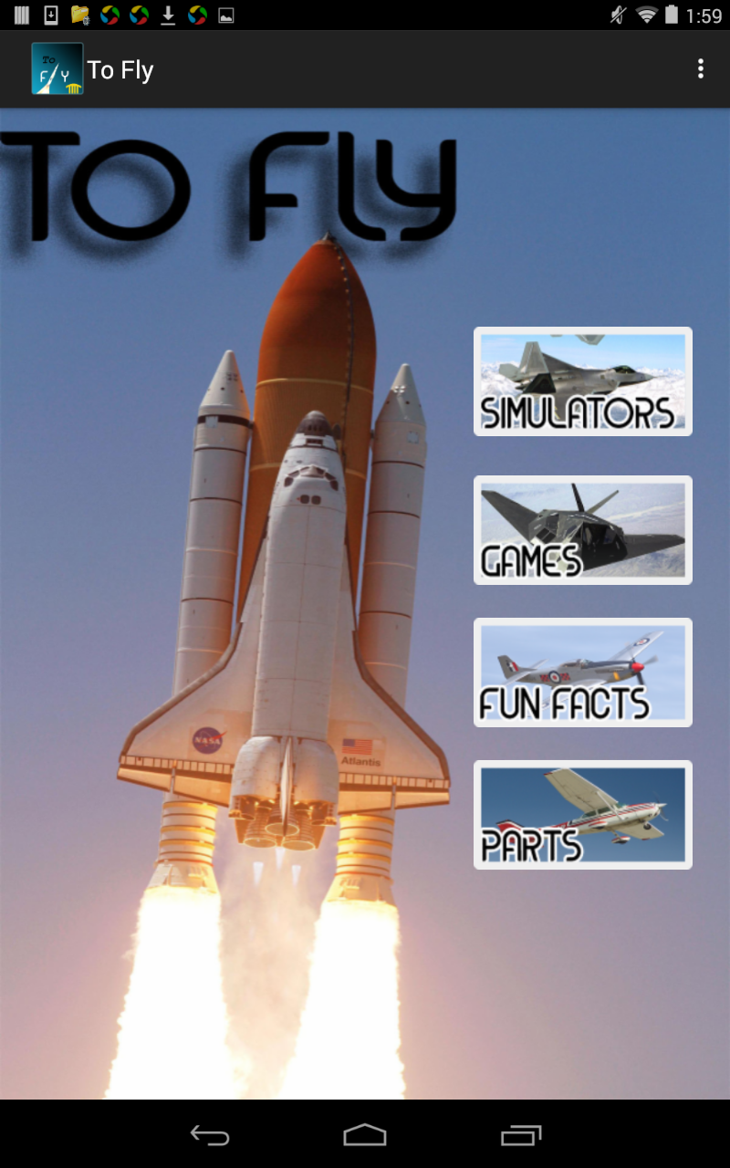
To Fly - Overview
Five main categories:
Simulators
Games
Fun Facts
Plane Parts
Map

Slide 4
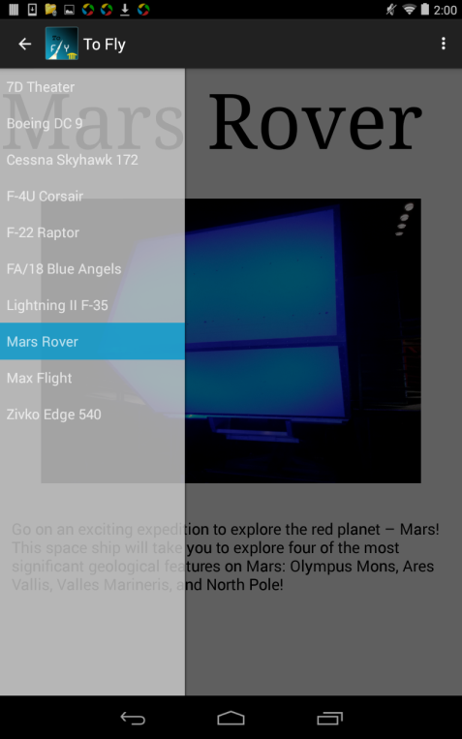
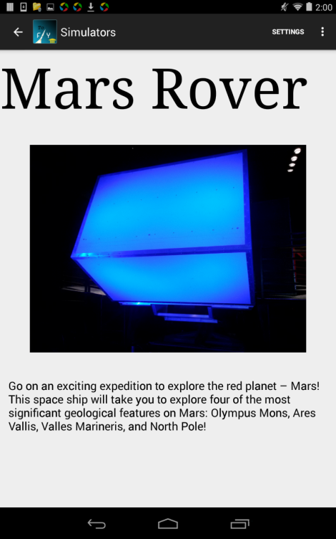
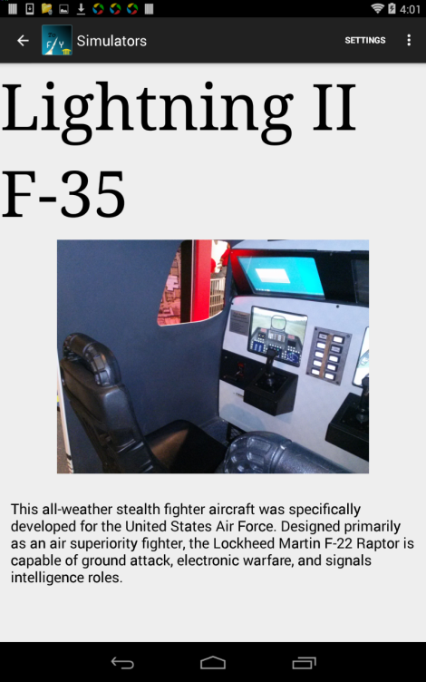
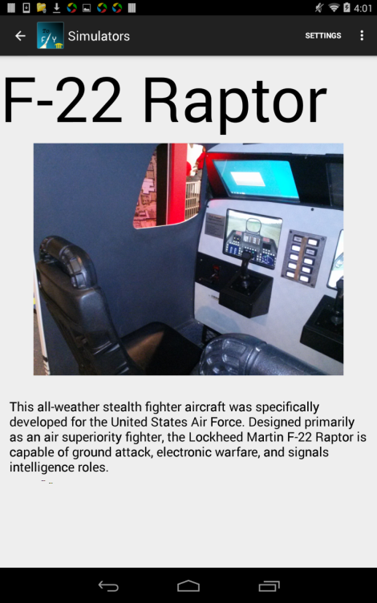
Simulators
Image of simulator
Details of the history and features of each unique aircraft
Gives more information on To Fly featured attractions, such as MaxFlight and 7D Theater

Slide 5
Games
Trivia Game:
10 Questions, multiple choice
Correct/Incorrect message is displayed after each question
Answers with explanation/additional info shown at end of quiz
Scavenger Hunt:
Not completed; for future development

Slide 6
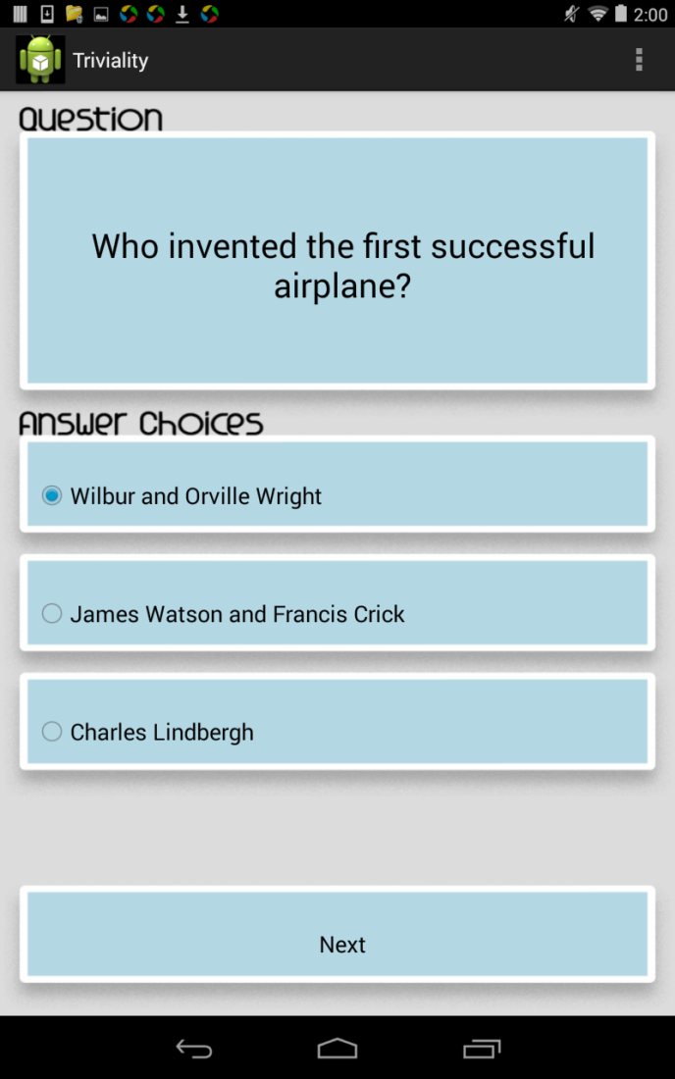
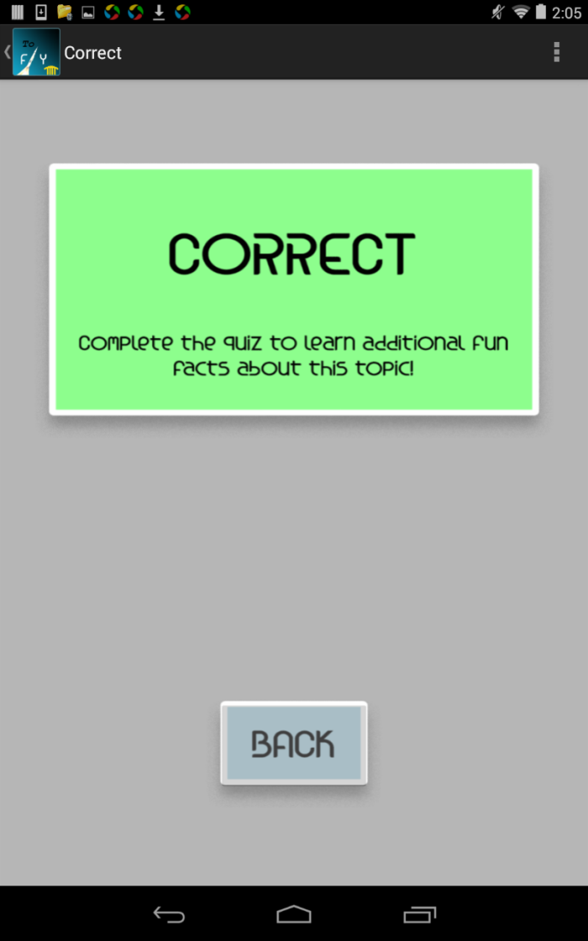
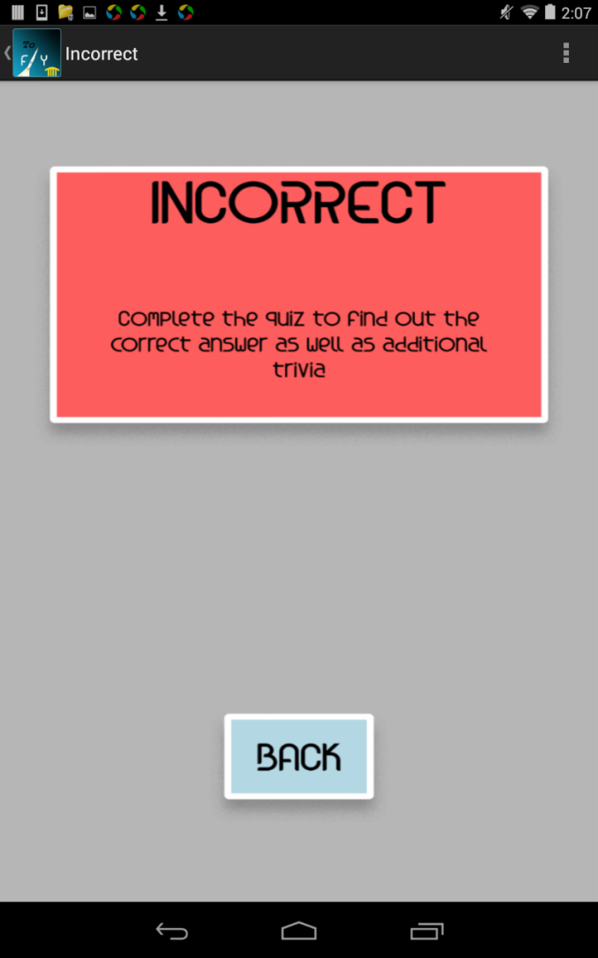

Slide 7
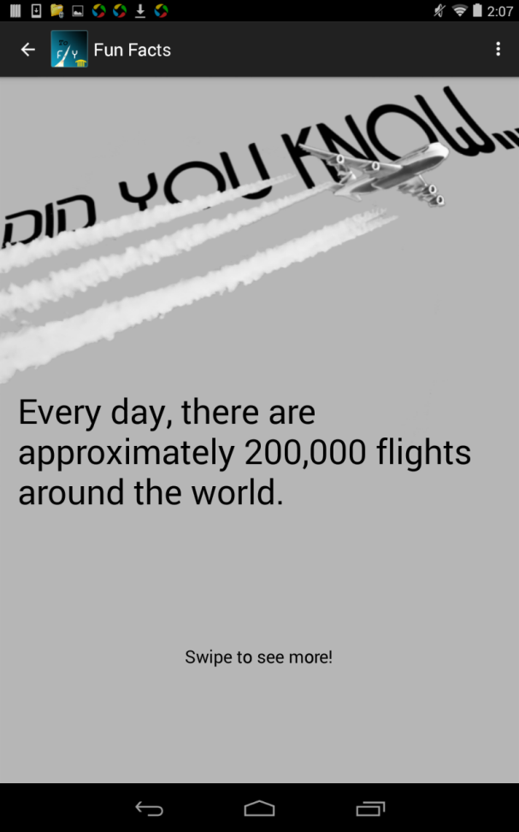
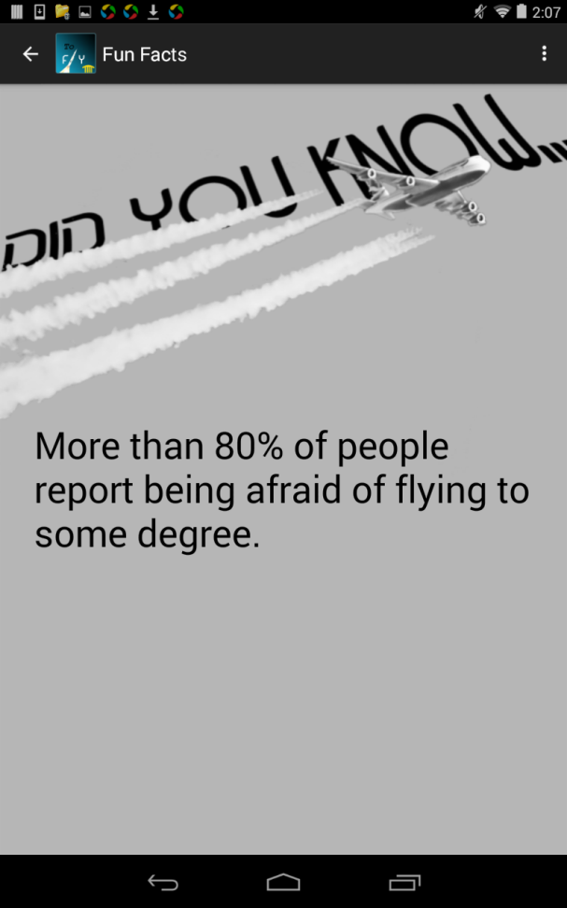
Fun Facts
Swipe View
10 Interesting “Did You Know” Fun Facts

Slide 8
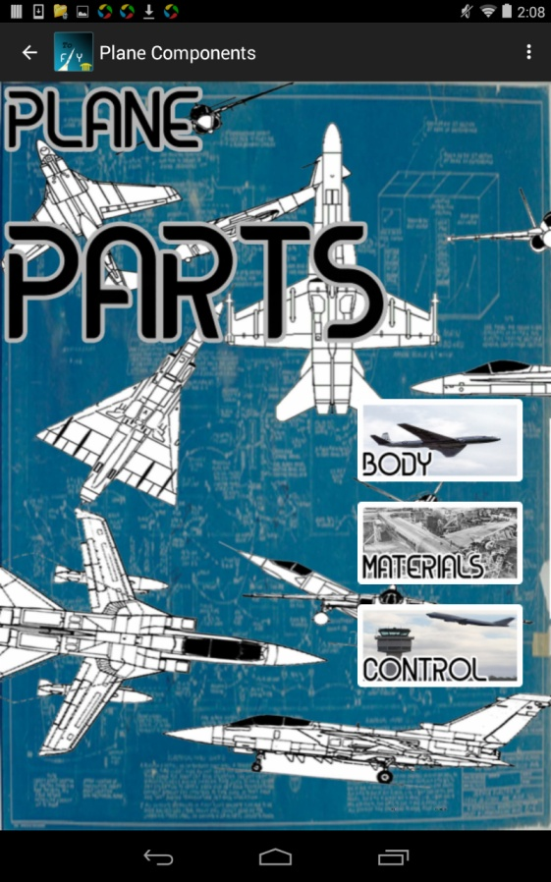
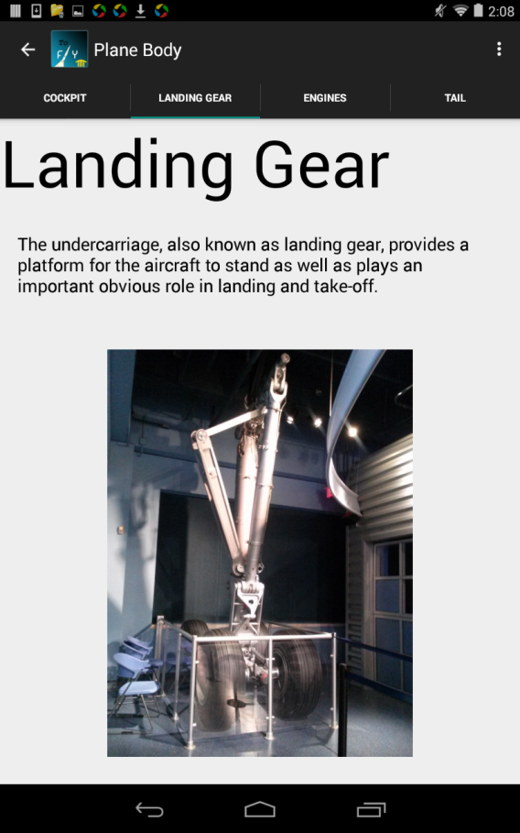
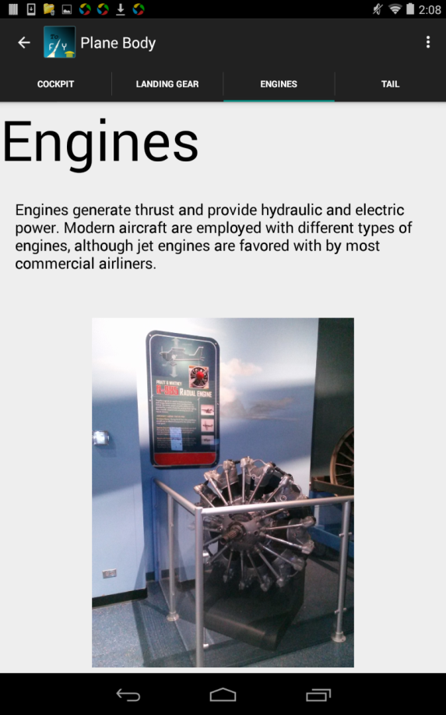
Plane Parts
Image and function of parts of a plane
Different types of materials used
Control Tower image and function

Slide 9
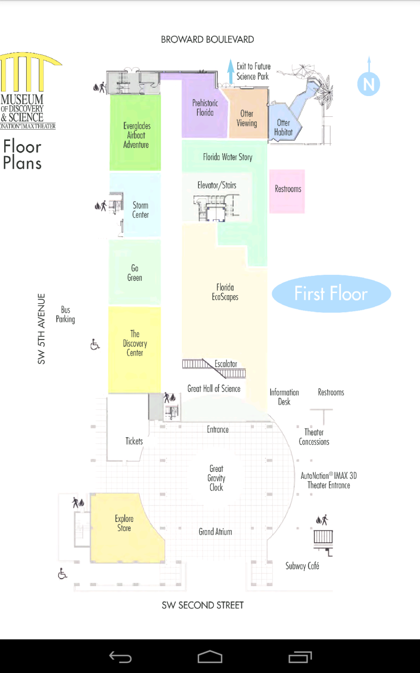
Map

Slide 10

Questions?

Slide 11
Thank You!!!
FAU Staff – Dr. Shankar, Professor McAfee, Santiago Aguerrevere, Demetrius Dukes, Alain Edwards, Dr. Mitsova-Boneva
Museum of Discovery & Science APPtitude Internship program – Summer Scarlatelli, Joe Cytacki

